Slide 1
Digital Portfolio
STUDENT NAME: S.JEMIMAL
REGISTER NO AND NMID: 30924UCS016&AUTANM309ANM30924UCSC019
DEPARTMENT: SECOND YEAR COMPUTER SCIENCE
COLLEGE: COLLEGE/ UNIVERSITY ANNAMALAI UNIVERSITY

Slide 2
PROJECT TITLE
RESPONSIVE PORTFOLIO SHOWCASE

Slide 3


AGENDA
Problem Statement
Project Overview
End Users
Tools and Technologies
Portfolio design and Layout
Features and Functionality
Results and Screenshots
Conclusion
Github Link
3/21/2024 Annual Review

Slide 4

PROBLEM STATEMENT
The goal of this "Web Development Portfolio" project is to address this challenge by providing S. Jemimal with a dynamic and visually appealing online platform. This portfolio will serve as a comprehensive digital resume, allowing her to:
Centralize her web development projects and skills in an organized manner.
Demonstrate her proficiency in HTML, CSS, and JavaScript through real-world examples.
Highlight her capabilities in responsive design and user experience.
Create a memorable and professional first impression with stakeholders, ultimately increasing her visibility and opportunities within the tech industry.

Slide 5

PROJECT OVERVIEW
This project focuses on the development of a personal online portfolio for S. Jemimal, a student from the Computer Science Department under the Naan Mudhalvan initiative. The primary objective is to create a professional, responsive, and visually appealing web presence that effectively showcases her skills, academic journey, and projects. The portfolio serves as a digital resume, offering a centralized platform for her to present her capabilities to potential employers, academic institutions, and collaborators, thereby enhancing her professional visibility and opportunities. The design emphasizes a vibrant, modern aesthetic using gradient backgrounds and intuitive navigation to provide an engaging user experience.

Slide 6

WHO ARE THE END USERS?
The primary end users for this portfolio are:
Recruiters and Hiring Managers: Individuals seeking to evaluate Jemimal's technical skills, project experience, and potential fit for internships or entry-level positions in web development or related fields.
Academic Faculty: Professors or research supervisors who might assess her practical application of computer science concepts for higher studies or academic projects.
Potential Collaborators: Peers or professionals looking for individuals with complementary skills for joint projects or initiatives.
Personal Network: Friends, family, and mentors interested in tracking her professional development and achievements.
S. Jemimal Herself: As a dynamic and easily updatable record of her progress and accomplishments.

Slide 7

TOOLS AND TECHNIQUES
The "Web Development Portfolio" is built using a modern and industry-standard stack to ensure flexibility, maintainability, and a high-quality user experience.
HTML5: The core markup language for structuring the content of the web pages, providing semantic meaning to different sections of the portfolio (profile, projects, skills, contact).
CSS3: Used for styling the web pages. While minimal custom CSS is present, the bulk of the styling is managed through a utility-first framework.
JavaScript (ES6+): Implemented for adding interactivity and dynamic behavior to the portfolio, such as smooth scrolling for navigation and a simple greeting message toggle.
Tailwind CSS: A highly customizable, utility-first CSS framework. It was chosen for rapid UI development, ensuring a responsive design that adapts seamlessly across various screen sizes (mobile, tablet, desktop) with minimal custom CSS writing. It also contributes significantly to the modern and attractive visual design.
Google Fonts (Inter): Utilized for typography, providing a clean, modern, and highly legible font choice across the entire portfolio.

Slide 8
POTFOLIO DESIGN AND LAYOUT
The portfolio's design focuses on attractiveness, user-friendliness, and responsiveness.
Color Scheme: A vibrant and inviting gradient background (from-purple-800 via-pink-600 to-red-500) sets a dynamic and energetic tone, complemented by contrasting yellow and white text for readability.
Layout: A single-page application (SPA) style is adopted, where all main sections are accessible via smooth scrolling navigation from the header. This provides a fluid and continuous user experience.
Responsiveness: Leveraging Tailwind CSS, the layout is fully responsive, ensuring optimal viewing and interaction on all device types (mobile, tablet, desktop) and orientations. Elements like the profile section and skill grids adapt their arrangement based on screen size.
Aesthetics:
Rounded Corners: Applied extensively to sections, buttons, and skill boxes (rounded-3xl, rounded-full, rounded-xl) to give a soft, modern, and approachable feel.
Shadows: Deep shadows (shadow-lg, shadow-xl, shadow-2xl) are used to create depth and highlight interactive elements and main content sections.
Hover Effects: Subtle transform hover:scale-105 and hover:-translate-y-1 transitions are added to sections and buttons respectively, providing visual feedback and enhancing user engagement.
Backdrop Filter: Sections use bg-opacity-10 backdrop-filter backdrop-blur-lg to create a semi-transparent, frosted glass effect over the vibrant background, adding sophistication.
Navigation: A fixed header with clear, clickable navigation links allows users to quickly jump between different sections of the portfolio.
8

Slide 9
FEATURES AND FUNCTIONALITY
The portfolio incorporates several key features to provide a rich user experience:
Profile Section: Displays a professional headshot, name, department, and a concise introductory message. Includes an interactive "Say Hello!" button that toggles a greeting message.
About Me (Details) Section: Provides a more detailed narrative of Jemimal's academic interests, inspirations (including the Naan Mudhalvan initiative), and personal hobbies related to tech.
Projects Section: Dedicated to showcasing a single, significant project. Each project entry includes a title, a brief description, and a link to view the project (currently a placeholder). This section is designed for easy expansion to add more projects as they are completed.
Skills Section: Lists core technical competencies (currently HTML5, CSS3, JavaScript) in an organized grid layout, making it easy for visitors to quickly assess her capabilities.
Contact Section: Offers a clear call to action with Jemimal's email address, enabling direct communication.
Responsive Design: The entire portfolio layout dynamically adjusts to screen size, ensuring a seamless experience whether viewed on a mobile phone, tablet, or desktop computer.
Smooth Scrolling Navigation: JavaScript is used to provide a fluid scrolling experience when clicking on navigation links, rather than abrupt jumps.

Slide 10
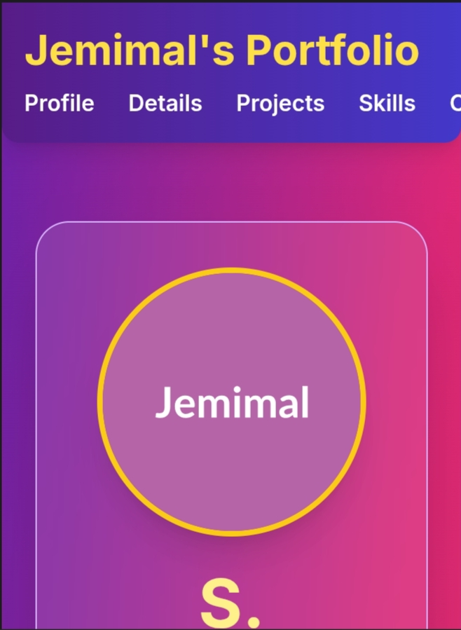
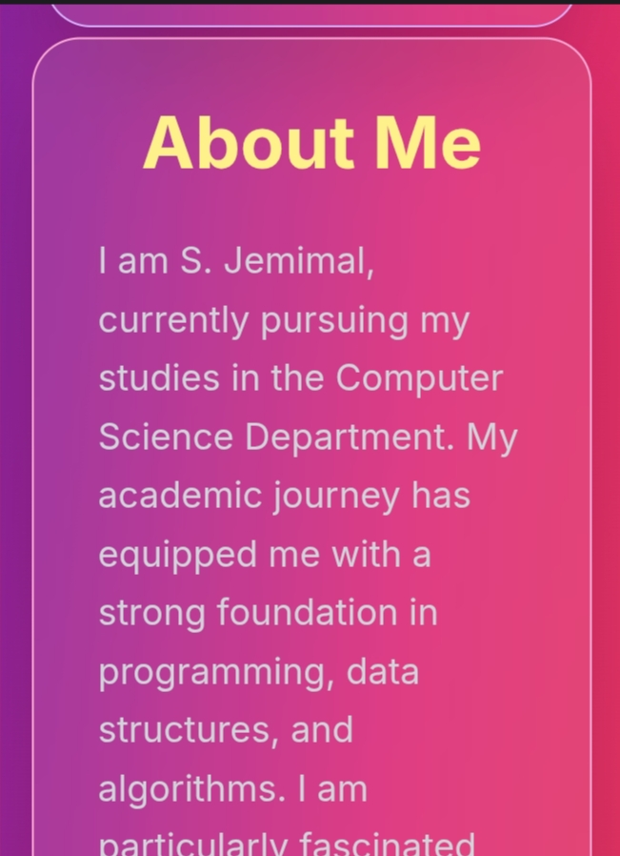

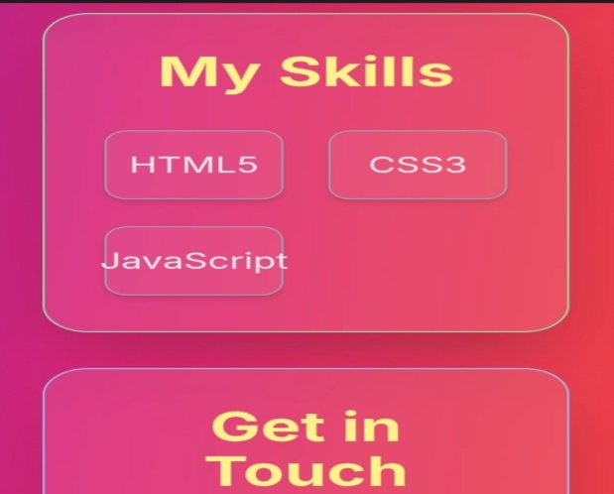
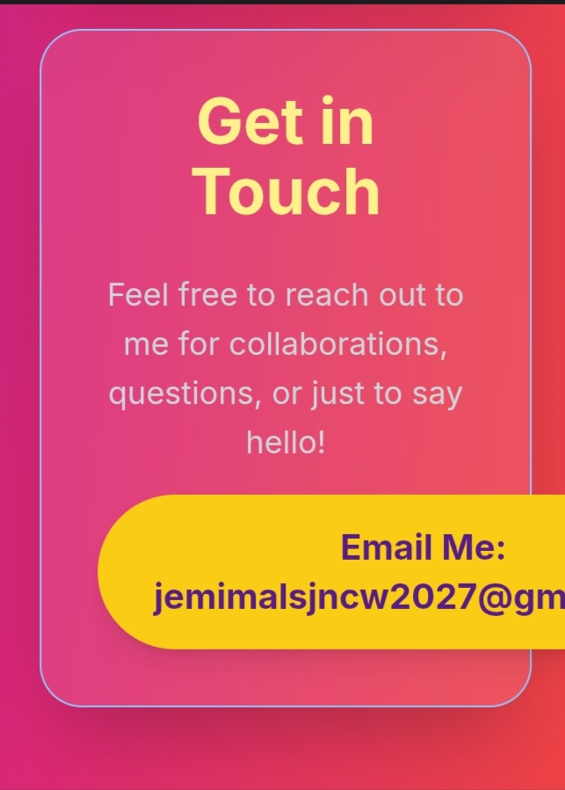
RESULTS AND SCREENSHOTS
3/21/2024 Annual Review
10

Slide 11
CONCLUSION
This "Web Development Portfolio" project successfully achieves its goal of providing S. Jemimal with a powerful tool to showcase her evolving skills and projects. By leveraging modern web technologies like HTML5, CSS3 (with Tailwind CSS), and JavaScript, the portfolio is not only functional but also aesthetically pleasing and accessible across all devices. This platform will be invaluable for her academic and professional journey, allowing her to confidently present her achievements and attract new opportunities. It stands as a testament to her foundational web development capabilities and her commitment to the Naan Mudhalvan initiative.
11

Slide 12
GITHUB LINK:
12

